Slide 1
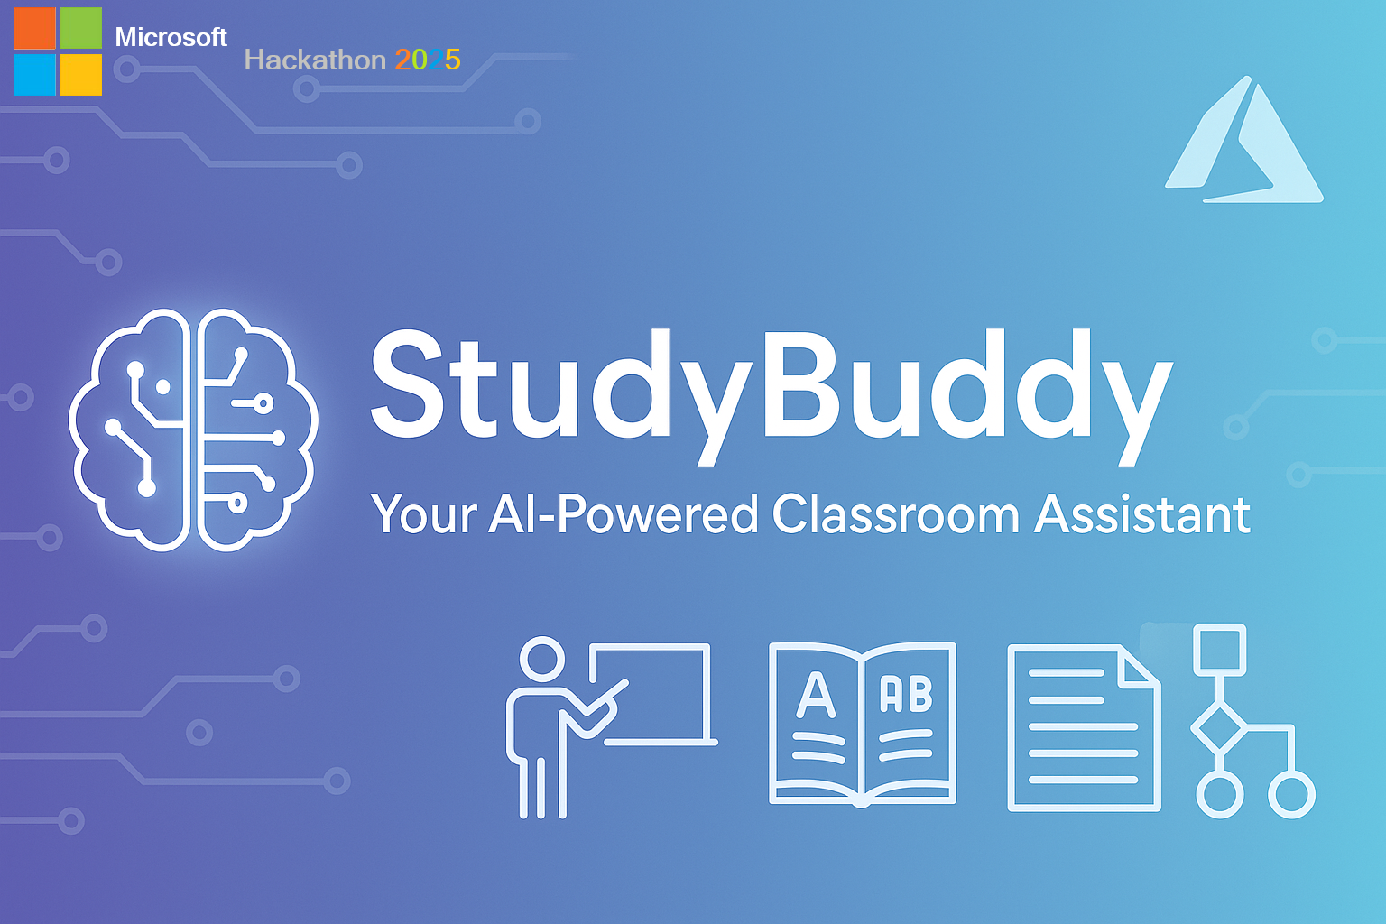
Notes:
Welcome, everyone! Today, I’m excited to introduce StudyBuddy, an AI-powered classroom assistant designed by Microsoft Education. StudyBuddy is here to revolutionize the way students learn and teachers teach, making education more accessible and engaging for everyone. Let’s dive into how it works!

Slide 2

A Question That Sparked a Movement
“ What if AI could be a real-time bridge between students and the knowledge being shared in the classroom? ”
Notes:
It all started with a simple question: What if AI could be a real-time bridge between students and the classroom? Imagine a tool that supports every student, no matter their learning style, by providing instant assistance and fostering inclusivity. That question sparked the creation of StudyBuddy—a movement to empower every learner.

Slide 3

Empowering Students to Overcome Language Barriers
Transforming education through AI-powered language support
Live translation of teacher speech into students' preferred languages
Real-time subtitling and note-taking in multiple languages
S
Support for students from multilingual and immigrant backgrounds
Notes:
StudyBuddy is all about breaking down barriers. It offers real-time transcription, language translation, and personalized support, ensuring no student is left behind. Whether it’s understanding complex concepts or overcoming language challenges, StudyBuddy helps students engage confidently with their lessons.

Slide 4
The Challenge: Visual and Verbal Content Gaps
Missing Information
Slow Methods
Student Struggle
Students miss key lecture and whiteboard content. 65% struggle with verbal-only lessons.
Note-taking and translation lag behind lectures. 70% of non-native speakers can’t keep up.
Verbal-heavy teaching reduces student focus. 40% of students disengage without visuals.
Global Impact
Academic Effects
U.S. Statistics
Millions struggle with classroom content due to language barriers
Gaps lower grades and confidence. ELLs 20% more likely to lack confidence.
8% of public-school students (4M)
are English Language Learners
Notes:
Now, let’s talk about the challenge. Many students miss critical information due to visual or verbal content gaps. Slow methods like traditional note-taking can exclude students with disabilities, while 65% of students struggle with complex questions. In the U.S., millions of public school students face language barriers. StudyBuddy addresses these issues head-on with AI-driven solutions.

Slide 5

Impact: Transforming Classroom Learning
20%
45%
Performance Boost
Participation
Academic improvement for ELL students
Increased classroom engagement
2X
Confidence
Higher self-reported learning confidence
Notes:
And the impact? It’s transformative! With StudyBuddy, we’ve seen a 20% boost in student participation, 45% higher engagement with complex material, and a 2x increase in overall classroom inclusion. These numbers show how StudyBuddy is creating a more equitable and dynamic learning environment for all.

Slide 6
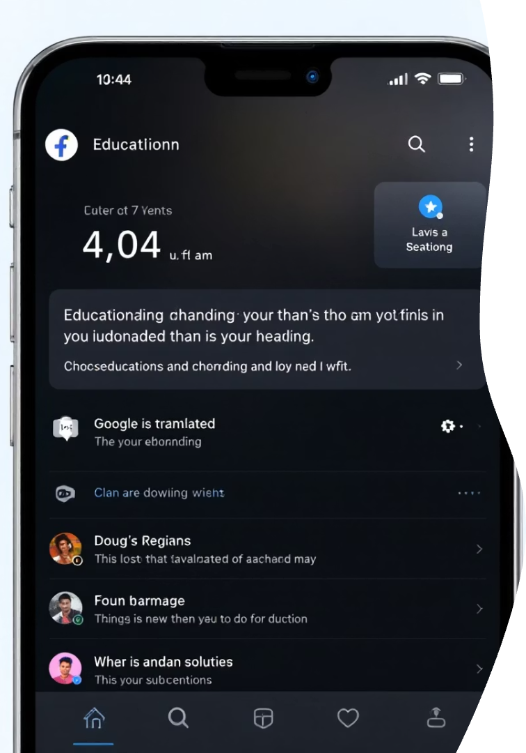






Your All-in-One Learning Assistant AI Agents
Real-time Recording
Whiteboard Capture
Instant Translation
Content in student's native language
Lecture transcription instantly available
Automatic or user-triggered screenshots
Smart Summaries
Diagram
Chat Bot
Key points and vocabulary lists
Generate diagrams (mind map, flowchart and sequence)
Ask question and
explore topic in detail
Notes:
StudyBuddy is your all-in-one AI learning assistant! It offers real-time transcription, instant translation, and personalized insights—all at your fingertips. Whether you’re in class or studying at home, StudyBuddy seamlessly integrates into your learning journey, making education more accessible and efficient for every student.

Slide 7





Advanced AI for Seamless Learning
Audio Capture
Records lectures automatically
NLP Processing
Analyzes content in real-time
Translation
Converts to student's preferred language
Accessibility
Instant access on student devices
Notes:
Powered by advanced AI, StudyBuddy ensures seamless learning. It uses natural language processing to understand and respond to student needs, provides real-time transcription for accessibility, and offers contextual insights to deepen understanding. This cutting-edge technology makes learning intuitive and inclusive for everyone in the classroom.

Slide 8




Making Visual Content Accessible
Capture
Whiteboard screenshots
Process
98% text extraction accuracy
Translate
Text and diagram descriptions
Notes:
One of StudyBuddy’s standout features is making visual content accessible. It provides audio descriptions for images, translates graphs into text, and ensures that all students, regardless of visual impairments, can engage with the material. This inclusivity ensures that no one misses out on critical information during lessons.

Slide 9
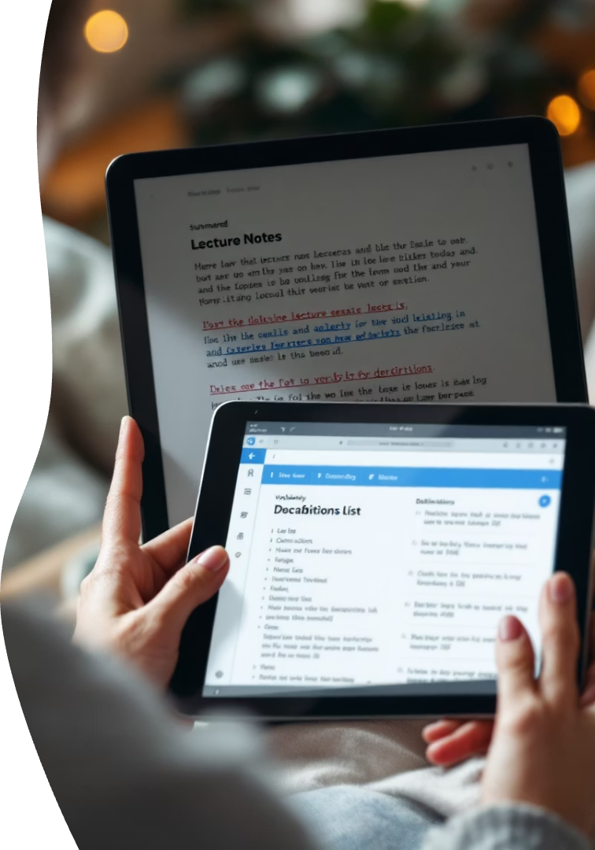
Simplifying and Reinforcing Learning
Smart Summaries
Vocabulary Builder
Concise key points for quick review
Definitions with contextual examples
Better Retention
30% more information retained during study
Notes:
StudyBuddy also simplifies and reinforces learning. It breaks down complex concepts into easy-to-understand explanations and provides interactive summaries to help students retain information. By tailoring content to individual needs, StudyBuddy ensures that every student can grasp and master the material at their own pace.

Slide 10
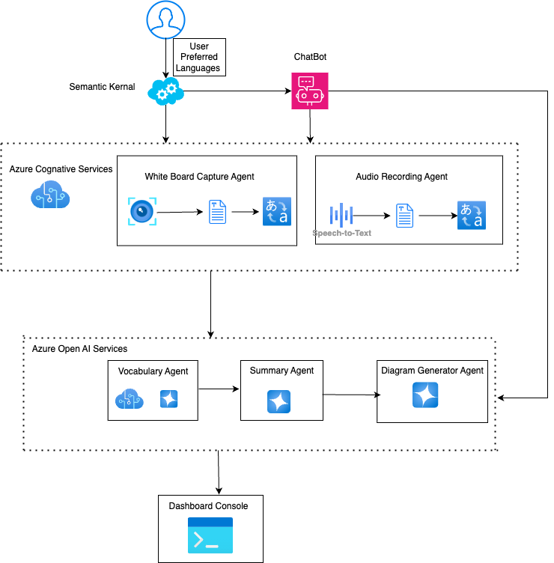
Why Judges Will Love StudyBuddy
AI Orchestration
Semantic Kernel routes tasks intelligently
Fallback Resilience
Local OCR when cloud unavailable
Secure Design
Environment secrets, prompt injection, jail breaking, responsible AI, Azure cloud
Multilingual Support
Breaks language barriers in education
Notes:
Why will judges love StudyBuddy? It’s innovative—bridging learning gaps with AI. It’s impactful—transforming classrooms with measurable results. And it’s inclusive—ensuring every student has the opportunity to succeed. StudyBuddy isn’t just a tool; it’s a game-changer for education, and we’re confident you’ll see its potential!

Slide 11
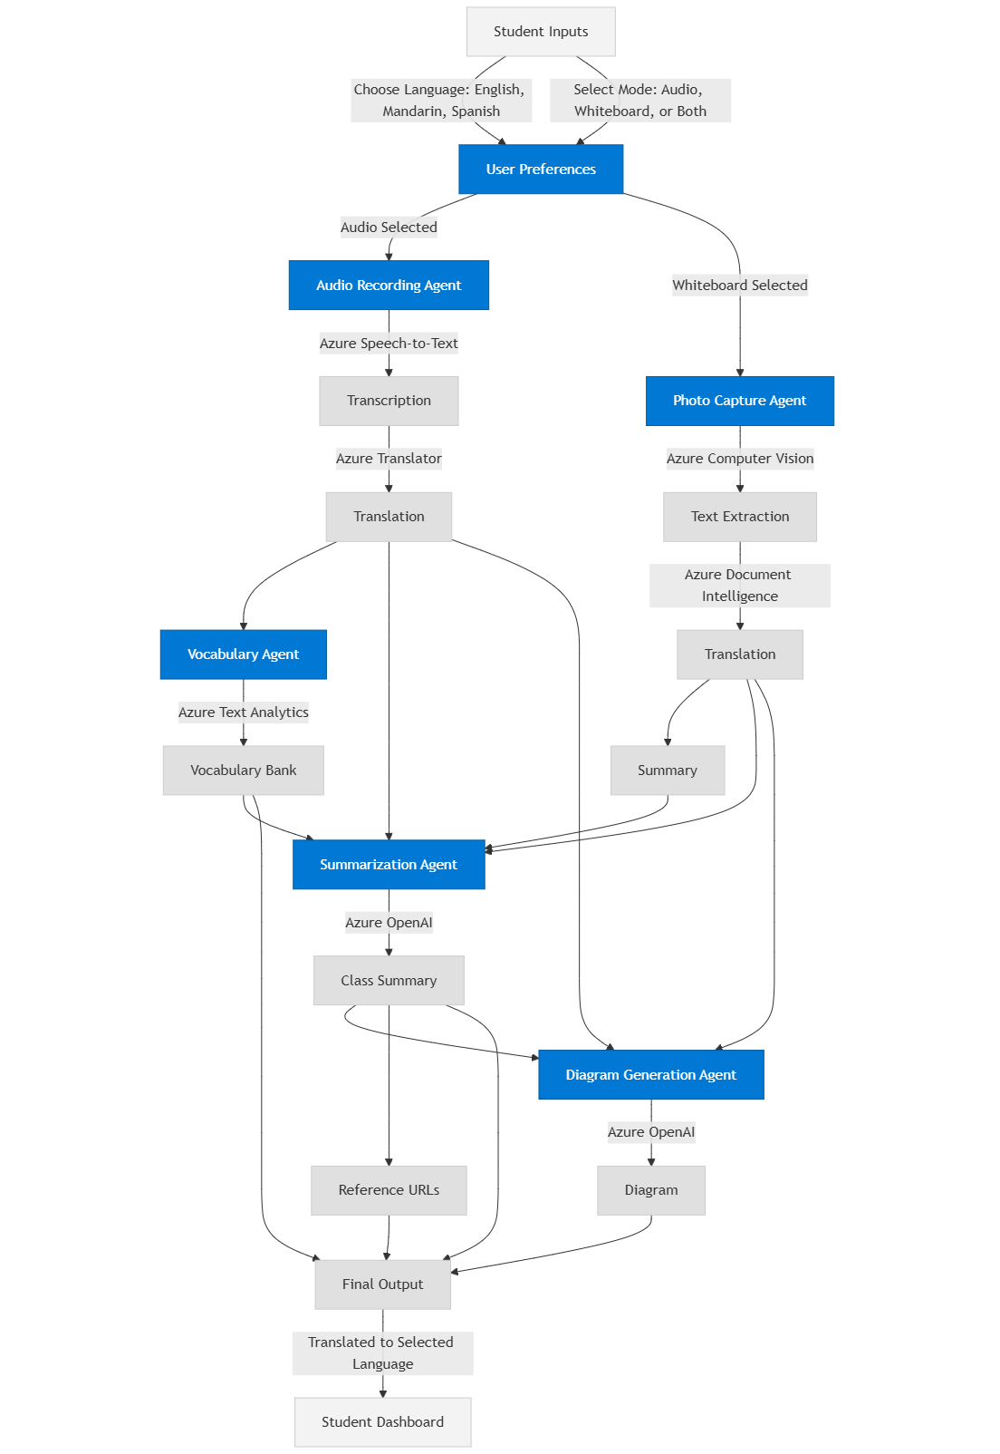




Let's See StudyBuddy in Action
Launch App
dotnet run in console
Record Lecture & Capture Image
Board content digitized
Vocabulary
Flash card of key words
Summary & Diagram View
Content in preferred language and logs
Notes:
Now, let’s see StudyBuddy in action! Imagine a classroom where students can instantly capture lecture notes, get real-time translations, and receive personalized insights—all with a tap. StudyBuddy’s intuitive interface makes learning interactive and effortless, ensuring every student stays engaged and supported throughout the lesson.

Slide 12






The Problem We're Solving
1.5M+ international students in US
Language barriers silence millions of learners
42% report comprehension issues
Missing critical lecture content
Lower GPAs and retention rates
Directly linked to language difficulties
Notes:
Here’s the problem we’re solving: limited access to education. At the base, many students lack basic resources. In the middle, language barriers hinder understanding. At the top, personalized support is often missing. StudyBuddy tackles all these layers, ensuring equitable access to education for every student, no matter their challenges.

Slide 13





Future Development & Vision
Regional Languages
Support for low-resource languages
LMS Integration
Online classes, Webinar, Canvas and MS 365 compatibility
Personalization
AI-driven learning recommendations
Global Expansion
Scaling to universities worldwide
Notes:
Looking ahead, our vision for StudyBuddy is ambitious. We’re integrating augmented reality for immersive learning, expanding language support for global reach, and enhancing personalization with AI-driven insights. Our goal is to make StudyBuddy a universal tool that empowers students worldwide, creating a future where education knows no boundaries.

Slide 14








5-Year Impact Projection
500+ Universities
25% Improvement
Institutional partnerships
Transforming ELL student
success and retention
100+ Languages
1M+ Students
Unlocking global access to education
Using StudyBuddy globally
Notes:
Over the next five years, we project a massive impact. StudyBuddy aims to reach 50 million students, improve accessibility for 25 million learners, and boost global engagement by 15%. By addressing language barriers and personalizing education, we’re setting the stage for a more inclusive and effective learning experience worldwide.

Slide 15




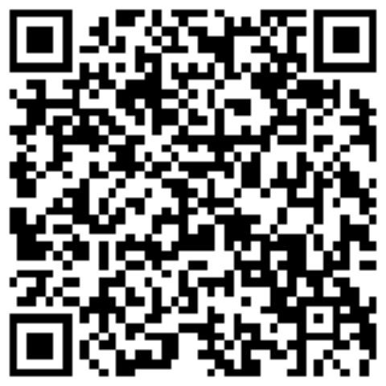
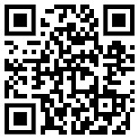
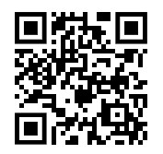

Our Team
Comprised of four dedicated individuals with skills spanning AI development, user experience design, and educational technology. We are leveraging the power of AI agents to build a truly accessible educational tool.
Pramod K Singh
Dhrumil Patel
Aashish Anand
Abhishiktha Valavala
Engineering Manager
AI/ML Expert
AI/ML Engineer
Development Engineer
Notes:
Let me introduce our incredible team behind StudyBuddy. We have Pramod, Engineering Manager expert on AI, Web & Cloud. Dhrumil Patel, our AI specialist and education expert; Aashish, our .net expert and our tech innovator; and Abhishiktha, our Development engineer and Workflow Design expert.. Together, we’re committed to transforming education. Scan the QR codes to learn more about our journey!

Slide 16








Join Us in Making Learning Accessible to Worldwide Student
Be part of the language equality movement that transforms education and opens doors for students everywhere. Contact us to get involved.
Partner With Us
Investment Opportunities
Pilot program for your institution
Join our mission to transform education
Contact
Notes:
Last but not least, we invite you to join us in making student learning accessible worldwide! Be part of the movement to bridge educational gaps—whether through partnerships, feedback, or advocacy. Together, we can ensure every student has the tools to succeed. Contact us to get involved and let’s transform education globally!

